Slide 1

Covid-19 Analysis
Submitted by:
Anmol Kumar(pd21_002)
Minal Jain(pd21_084)
Pragya Kumari(pd21_033)
Aditya Tomar(pd21_014)

Slide 2

Project Overview
In our comprehensive analysis, we thoroughly explored profound impact of Covid-19 on our nation, its varying effects across different states, as well as the overall impact on public life.
Through insightful visualizations, we present a detailed account of the number of confirmed cases, recoveries, deaths, tests conducted and vaccination drive.
Overall, our project demonstrates the power and effectiveness of using Python, SQL and Excel to analyze COVID-19 data. By automating data extraction, handling missing values, and leveraging SQL's querying capabilities, we were able to provide accurate and up-to-date insights.

Slide 3
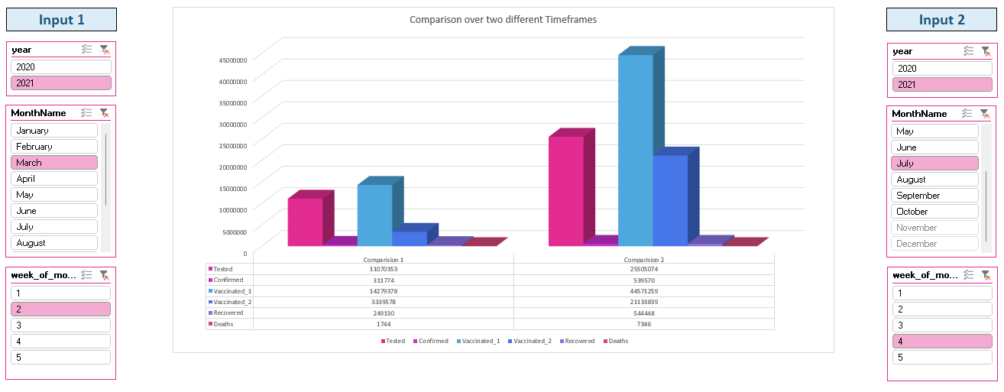
Analysis and comparison of the weekly progression of confirmed cases, recovered cases, deaths, and tests conducted.

Slide 4
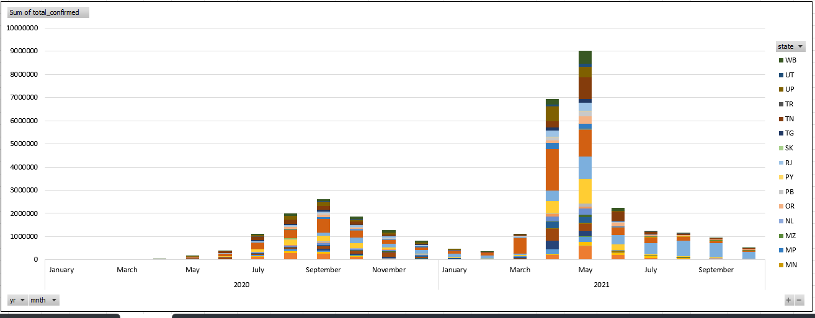
During the months of April and May 2021, India experienced a significant surge in COVID-19 cases, accounting for 20% and 26% of the total cases respectively. These months marked a challenging period for the country in terms of the highest number of reported infections.

Slide 5
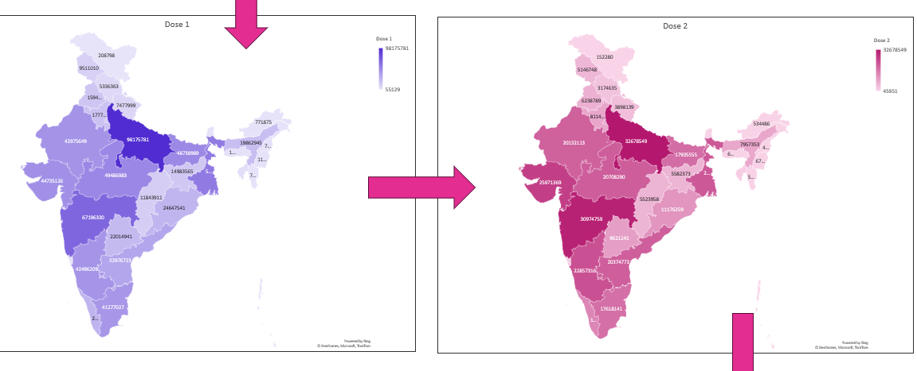
55% of the Indian population has received one dose and 25% of the Indian population has received both doses till date 31/10/2021.

Slide 6
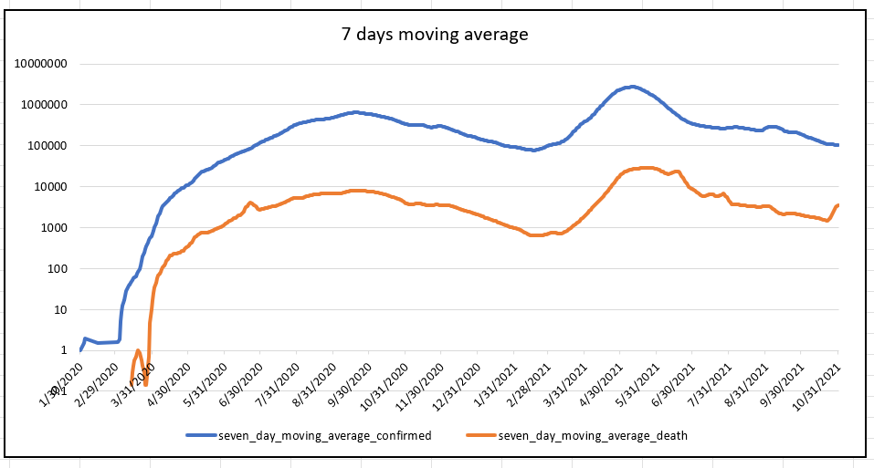
Below graph illustrating the 7-day moving average of confirmed cases and deaths in India.

Slide 7
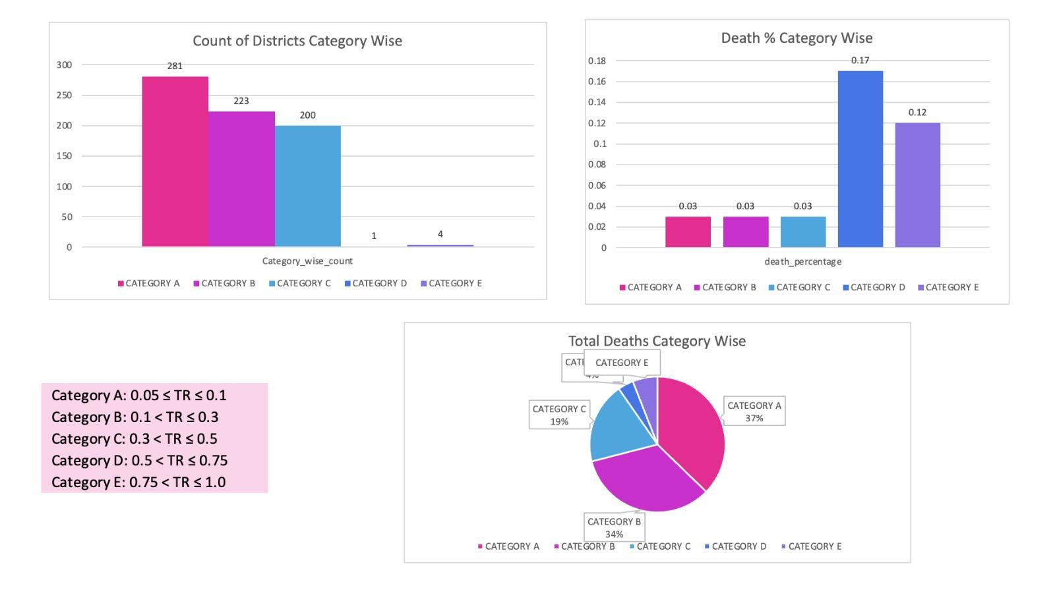
Analysis of the number of deaths across all categories based on the testing ratio.

Slide 8
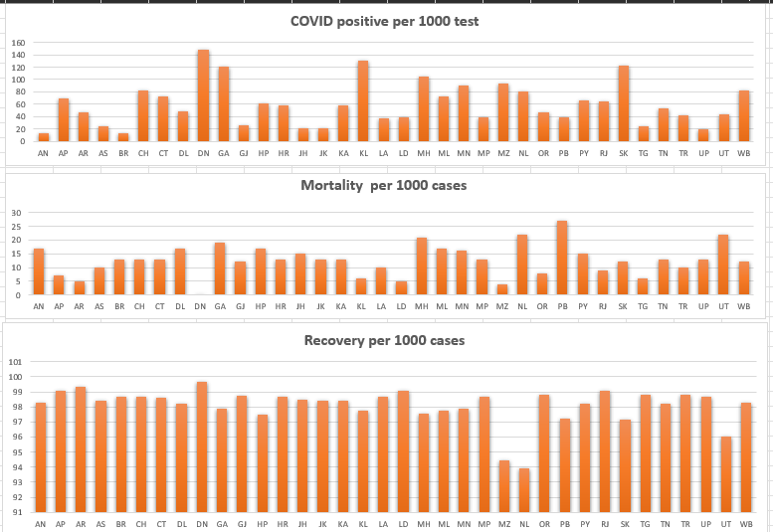
Analysis of COVID-19 data in different states adjusted per 1000 cases.

Slide 9
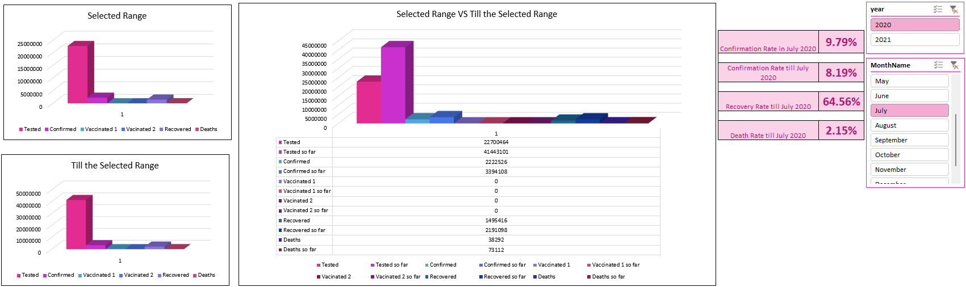
Our Covid-19 Insights Dashboard aims to provide a comprehensive and concise overview of the pandemic situation in our nation.

Slide 10
Conclusion
Between January 2020 and October 2021, India witnessed a total of 34 million COVID-19 cases, with approximately 450,000 individuals losing their lives as a result of the virus.
The initial wave of COVID-19 in India commenced in March 2020, reaching its pinnacle in September of that year, followed by a gradual decline. Subsequently, a second wave emerged in March 2021, culminating in May, and significantly contributing to the highest number of cases observed in India.
By analyzing the data on a state-wise basis and over time, this study was able to assess the varying severity of the COVID-19 outbreak across different regions in India. It also examined the role of vaccination in mitigating the mortality rate and reducing the overall impact of the virus.
The analysis of this dataset opens avenues for further research, such as investigating the impact of socioeconomic factors, healthcare infrastructure, and vaccination strategies on the COVID-19 outcomes in India.

